Slide 1




BRAND STYLE GUIDE

Slide 2

CONTENTS
VISION, MISSION AND VALUES
INTRODUCTION
VISION
MISSION
BRAND ELEMENTS
INTRODUCTION
CCM LOGO
LOGO COLOUR PALETTE
BLACK AND WHITE LOGO VARIANT
CLEAR SPACE GUIDELINE
BACKGROUND PLACEMENT GUDIELINES
HOW NOT TO USE THE CCM LOGO
TYPOGRAPHY
BRAND COLLATERAL
EMAIL SIGNATURE
COMPLIMENTARY CARD
IDENTITY CARD
ROLLUP BANNER

Slide 3
VISION, MISSION AND VALUES
INTRODUCTION
VISION
MISSION

Slide 4
INTRODUCTION
The Country Coordinating Mechanism (CCM) Nigeria is a national multi-sectoral body established in 2002 to coordinate and facilitate the Global Funded activities to Fight HIV/AIDS, Tuberculosis and Malaria Program in Nigeria.
CCM Nigeria is a mechanism for the coordination of public-private partnership efforts to access and utilize Global Fund financing and other relevant donor funding streams in support of national disease programs in Nigeria.
CCM members represent the interests of all stakeholders in the fight against HIV, TB, and malaria including those with roles in health systems strengthening.

Slide 5
VISION
The mandate of the CCM Nigeria is to make contributions that enhance the Global Funded- programs' performance, while providing the link between Global Fund operations, CCM member, constituencies, and Nigerian stakeholders.
MISSION
The purpose of the CCM Nigeria is to submit viable and appropriate proposals to the Global Fund, and to oversee and support the implementation of projects that are initiated by the CCM Nigeria and financed by the Global Fund.

Slide 6
BRAND ELEMENTS
CCM LOGO
LOGO COLOUR PALETTE
BLACK AND WHITE LOGO VARIANT
CLEAR SPACE GUIDELINE
BACKGROUND PLACEMENT GUDIELINES
HOW NOT TO USE THE CCM LOGO
TYPOGRAPHY
PHOTOGRAPHY

Slide 7
CCM LOGO
The CCM Logo signifies motion, progress and commitment. The red, blue and orange colours represent HIV, Tuberculosis and Malaria respectively (also in alignment with GF logo). The Green colour signifies: service, progress, health and renewal (in addition to being Nigeria’s official colour with white)
The 3 dots are reflective of CCM’s desire to reduce the burden of each disease to the barest minimum. The idea here is that dots represent the barest minimum portion of a phenomenon.
HIV
Malaria
Tuberculosis
The logo must always appear in its entirety and without distortion.

Slide 8
LOGO COLOUR PALETTE
All logo colours are fixed and cannot be altered.
To accurately reproduce each logo colour for different types of media using various screen and printing processes, refer to the specifications under the respective colour described on this page.
Green
PMS 368 C
C:94 M:0 Y:98 K:33 HEX #0BAA03
R:11 G:170 B:3
Blue
PMS 293C
C:100 M:60 Y:0 K:0 HEX#0066BB
R:0 G:85 B:170
100% Black
C:0 M:0 Y:0 K:100
HEX#666666 R:30 G:30 B:30
Red
PMS 1795C
C:15 M:100 Y:100 K:0
HEX#CC2222 R:205 G:32 B:44
Orange
PMS 130C
C:0 M:37 Y:100 K:0
HEX#FFAA22 R:255 G:170 B:34
Note that CMYK colours should be used for multicolour prints, although they can also be used in combination with Pantone (PMS) colours. RGB colours should be used for on- screen use, such as websites and presentations.

Slide 9

LOGO ON BLACK OR WHITE BACKGROUND VARIANT
The CCM logo has two variants, each designed to be used on specific background colors:
Logo Variant with "Nigeria" in White:
This variant of the logo is intended to be used on black or dark background surfaces. The main elements of the logo, including the CCM symbol and other text, are designed in white to ensure visibility and contrast against dark backgrounds.
Logo Variant with "Nigeria" in Black:
This variant of the logo is specifically designed for white or bright background surfaces. The "Nigeria" text is rendered in black to ensure legibility and prominence against light backgrounds, allowing for clear visibility and visual impact.
It is important to use the appropriate logo variant based on the background color to maintain visual consistency and readability.
Please note that using the correct logo variant enhances the logo's visibility and ensures that it remains consistent and recognizable in different contexts

Slide 10

CLEAR SPACE GUIDELINES
A minimum clear space must surround the CCM logo. Graphic elements or text must not be placed in this space, which is equal in size to at least 2X cap-height of logo. Remember to follow the “2-X-T rule”.
clear space
cap-height
clear space
2X cap-height
The protective area must always be a part of the document, page or screen shot on which logo is placed. For example, you should never allow any part of the logo graphic to touch the edge of a page or bleed off the edge of a page.
LOGO USAGE: MINIMUM LOGO SIZE
The size of the logo lockup must never be smaller than 30mm (1.2in) in print or 150 pixels on screen.
30mm
150 px

Slide 11






BACKGROUND PLACEMENT GUIDELINES
When the CCM Nigeria logo is to be used on. varied backgrounds, only the variations shown
below are allowed.
Light Colour or Light Photographic Background
DO NOT use full-colour logo on colour or photographic backgrounds
Note that the full-colour version of the logo should only appear on white backgrounds.
X
Dark Colour or Dark Photographic Background
White Background
X X

Slide 12






HOW NOT TO USE THE CCM LOGO
The logo must be used as described in this document, without any additional creative elements, highlights, drop shadows
or frames. No alterations are to be made to the
logo, as they alter its integrity and are detrimental to our brand.
DO NOT stretch, compress or distort the logo in any way.
DO NOT use on a complex background
X
X
DO NOT add text or make any additions to the logo
DO NOT change the colours in any way
DO NOT stretch, compress or distort the logo in any way.
DO NOT change the colours in any way
DO NOT use a different typeface for the logo
DO NOT use on a complex background
DO NOT add text or make any additions to the logo
DO NOT use any part of the logo separately
X
X
DO NOT use a different typeface for the logo
DO NOT use any part of the logo separately
X
X

Slide 13
TYPOGRAPHY
CCM Nigeria uses the Georgia font family type as the primary typeface. Weights are Bold, Italics and bold Italics. Although inspired by the need for - and providing - clarity at low resolutions on the screen, Georgia is a typeface resonant with typographic personality. Even at small sizes the face exudes a sense of friendliness; a feeling of intimacy. 11-12 points recommended font size
Primary Typeface
Georgia
Georgia Bold
Georgia Bold Italic
Georgia Italic
Complimentary Typeface
The Helectiva font family type is a complementary typeface to Georgio and is used to create neutral typeface.

Slide 14






PHOTOGRAPHY
“Action speaks louder than words”. Photography is that medium that can capture the action and help tell CCM’s story in a way that words cannot. Photos provide visual context for an article or publication and help create an emotional connection with CCM’s work.
Vibrant, sharp, and professionally captured images that convey a sense of positivity and professionalism are recommended. The CCM Secretariat keeps a digital asset library, and it has a collection of photographs approved for publication and available for use in relation to the CCM’s activities.

Slide 15
PHOTOGRAPHY GUIDELINES
Documenting a photograph’s source and maintaining its quality are requisites. Here are some things to keep in mind. Credit Information
Quality Originals
For digital or offset printing, the following specifications are required for acceptable reproduction.
Published photos from a stock agency should be credited to the photographer and the stock agency.
Individual photographers also require photo credits.
Double-check the spelling of names in photo credits.
Use this format for credits: Author/Agency.
Original digital photography is preferred.
Digital images must be 300 dpi (dots per inch) at
100% of the publication size.
Four-color transparencies, 35mm or 4x5 film are acceptable.
For example:
Omoh Edo/CCM
Chinwe Ojo/Integrity Pictures
Spell out the agency name in full, except CCM.
Prior to publication, get information about the photograph for a caption
Release Form ???

Slide 16
BRAND COLLATERAL
Email Signature
Business Card
Letterhead
Identity Card
Rollup Banner
PowerPoint Template

Slide 17
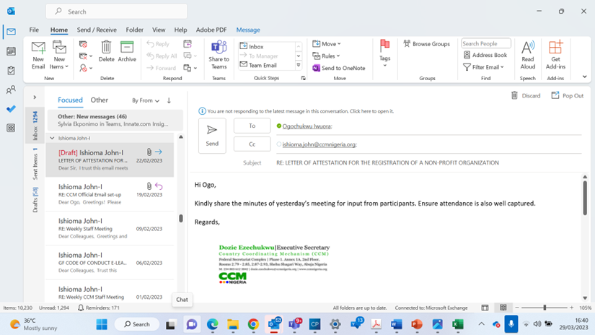

EMAIL SIGNATURE
This email signature is at the end of the email and includes professional contact details and CCM branding. The email signature makes emails trustworthy by showing the recipients whom they're corresponding with. CCM Secretariat employees should include an automatic email signature block in each new email that goes out from their email accounts. This will help ensure that your business contacts are able to easily reach you by other means

Slide 18
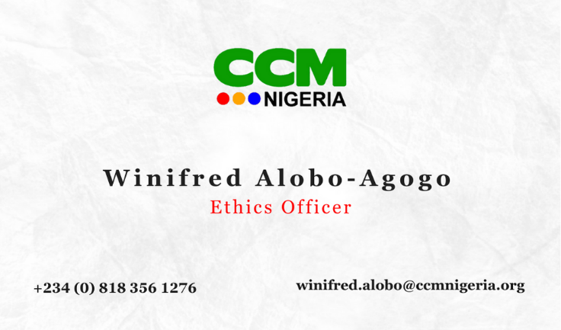

Business card
CCM Secretariat business card ensures that staff has quickly branded materials for communicating their contact information as well as CCM’s information during stakeholder networking. CCM business card matches the CCM stationery system paper.
.
Front View
  Full-colored logo at the top on the front view.
  Staff’s name and position.
  Staff’s contact information
  Use a white background.
  Back View
    Include FGN and donor logos at the bottom.
    Logos should be of equal size.
  The shade of colors should match the logo shade.
Front view
Back view

Slide 19

Letter Head
The address is centered across the bottom of the page. For the main body of the letter, follow the general letterhead guidelines in the Formatting section. Templates are available on CCM Website @ www.ccmnigeria.org
The full-colored logo must appear at the top center.
Based on CCM’s typography, the body of the letter should be in Georgia font, size 11-12 recommended.
The address and contact information is centered at the bottom of the page (Georgia font, size 9).
Hard copy paper type: Classic Crest, Avon brilliant white.

Slide 20

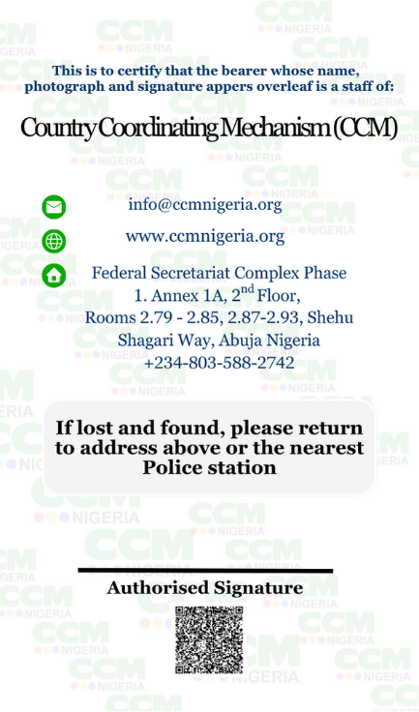
ID CARD
This provides at one glance all information that helps identify the bearer as a staff of the CCM Secretariat. It includes professional contact details and CCM branding. The design style aligns with the business card as both are forms of identification of the bearer and their association with CCM.
CCM logo should be placed at the top of the front view.
The front page should include:
  Passport Photograph
  Staff’s name and position
  Staff’s signature
  FGN and Donor’s logos.
  The back view
    Organization’s contact address.
    Organization’s contact information.
    Authorized signature
Avoid stylish fonts.
Avoid clashing colors- use a white background with a backdrop of the organization’s logo.
The color of design elements should not contrast with the logo colors.
Organization’s address should be indicated on the back.
Front view
Back view

Slide 21
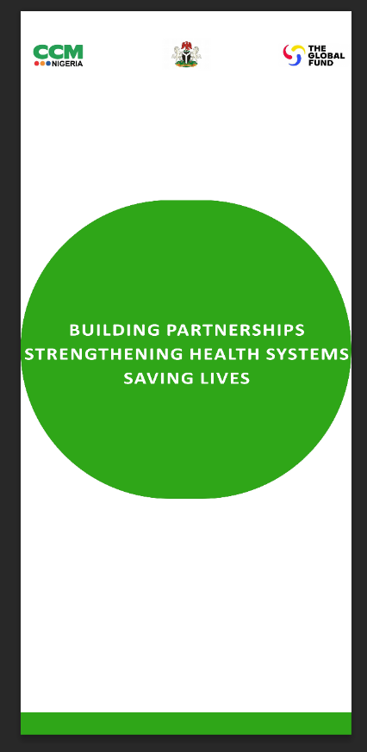
GENERIC ROLL-UP BANNER
Keep logos at the top/eye level to grab attention.
Banners should be visually appealing (use high-quality images.)
Colors used should be in sync with the organization’s colors.
For the sake of logo relationships, the Global Fund, CCM, and the Federal Government of Nigeria’s or other partners’ logos should be of equal size to avoid accidental ranking.
Logos should be placed horizontally not vertically.
Ensure minimal and clear space requirements around logos are conformed to.

Slide 22
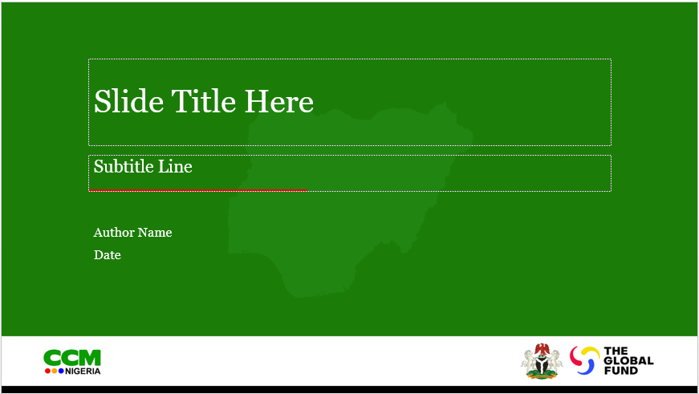

PowerPoint Template
The three logos (all equal size) should always appear on the front cover.
The green shade of the logo should always be the main color for design elements.
Recommended fonts:
  Georgia
  Times New Roman
  Gills Sans
  Calibri
  Be consistent
  Make sure font sizes, headers, and bullets are consistent from start to finish.

